Slide 1
Pokemon Combat
Rahul Sethi, Cheng Miao, Hao Cheng

Slide 2
Data Source
Download the dataset from Kaggle
https://www.kaggle.com/terminus7/pokemon-challenge/data

Slide 3

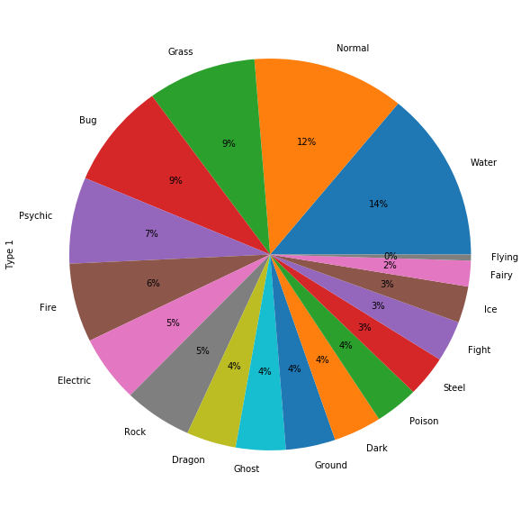
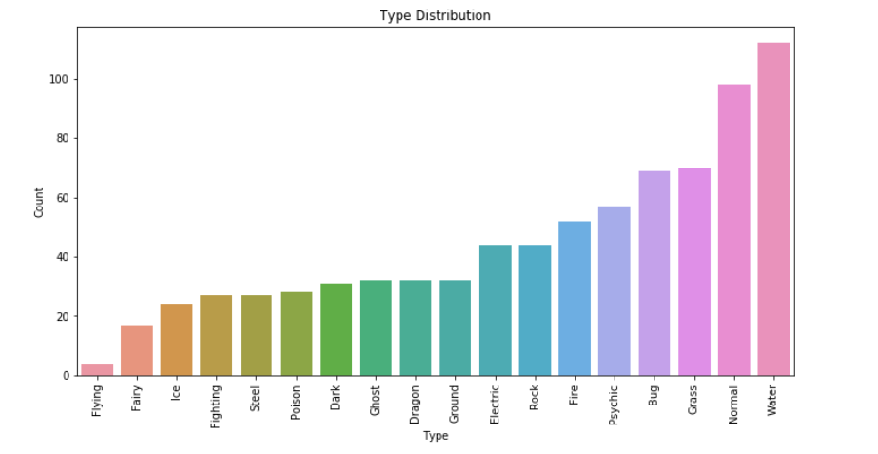
EDA

Slide 4
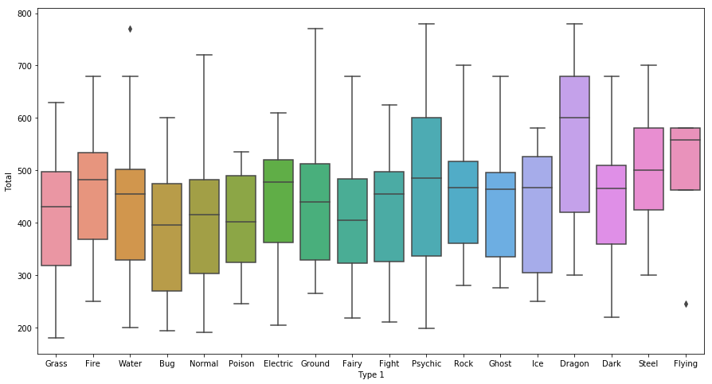

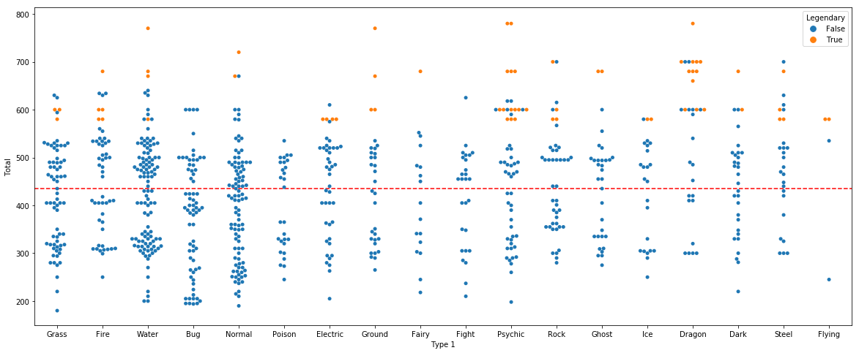
EDA

Slide 5
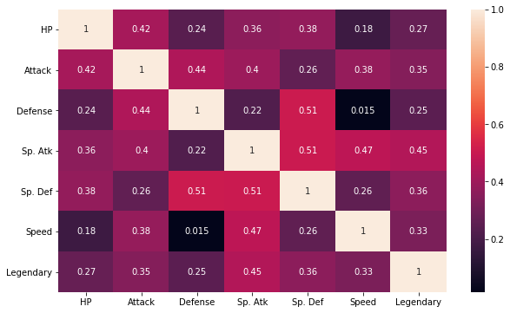
Correlation

Slide 6
Methods:
Naive Bayes Support Vector Machine Random Forest K-NN

Slide 7
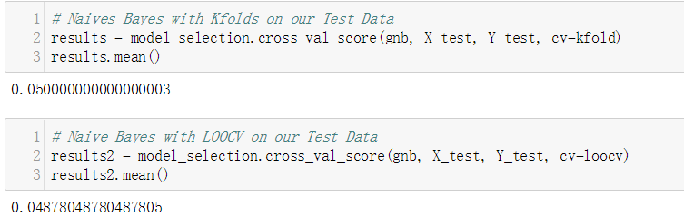

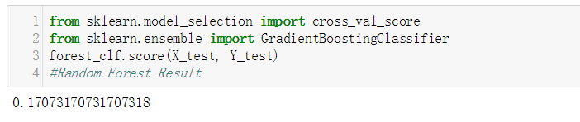
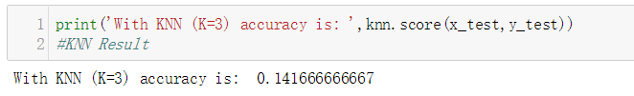
Bayes Result
SVM Result
Random Forest Result
KNN Result

Slide 8
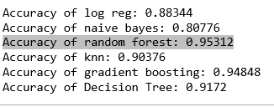
Predicting The Winner

Slide 9
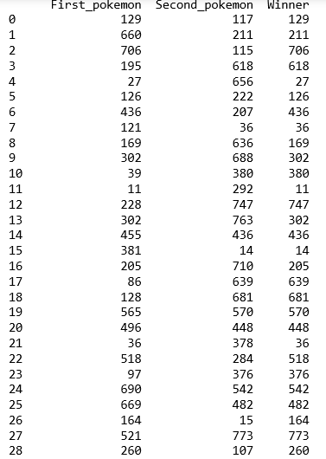
Test Result

Slide 10

Q&A

Slide 11
Thank You!

